Slide 1
Web based Programming
2.Introduction to HTML and XHTML

Slide 2

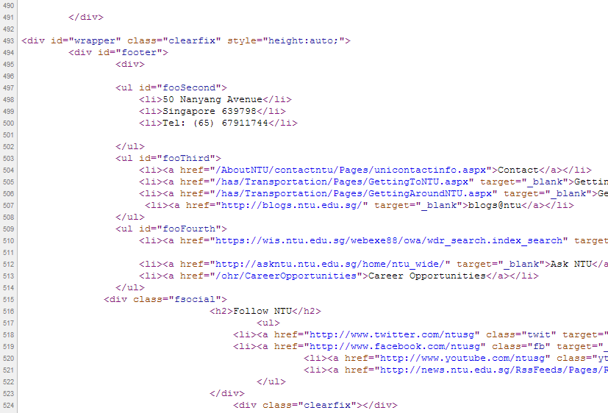
2.1 Origins and Evolution of HTML

Slide 3
2.1 Origins and Evolution of HTML
Original intent of HTML: general layout of documents that could be recognized and displayed by a wide variety of servers and client browsers
HTML
  Defined by Standard Generalized Markup Language (SGML)
XHTML
  Defined by eXtensible Markup Language (XML)
HTML is formatted document, NOT a program

Slide 4
2.1 The first HTML example
Example2-1.html

Slide 5
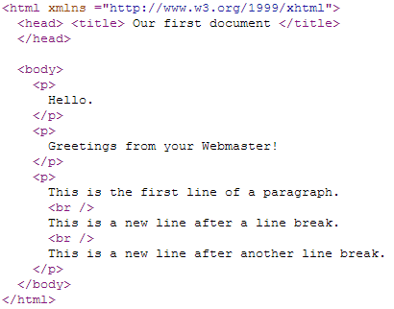
2.2 Basic Syntax (1)
The fundamental syntactic units of HTML are called tags
In general, tags are used to specify categories of content
  For each category, a browser has default presentation specification for the specified content

Slide 6
2.2 Basic Syntax (1)
The fundamental syntactic units of HTML are called tags
In general, tags are used to specify categories of content
  For each category, a browser has default presentation specification for the specified content
Most tags appear in pairs
Tag format:
  Opening tag: <name>
  Closing tag: </name>
The opening tag and its closing tag together specify a container for the content they enclose
The container and its content together are called an element
Not all tags have content
  If a tag has no content, its form is <name />

Slide 7
2.2 Basic Syntax (2)
Attributes are used to specify alternative meanings of a tag
  If a tag has attributes, they appear between its name and the right bracket of the opening tag
  Attribute format: attribute name = "attribute value "
  e.g., <img src = "http://www3.ntu.edu.sg/image.jpg" height = "200" width = "200"/>
Comments in HTML improve the readability of documents
  Comment form: <!-- … -->
Browsers ignore comments, unrecognizable tags, line breaks, multiple spaces, and tabs
Tags are suggestions to the browser, even if they are recognized by the browser

Slide 8
2.3 Standard HTML Document Structure
<html>, <head>, <title>, and <body> are required in every document

Slide 9
2.3 Standard HTML Document Structure
<html>, <head>, <title>, and <body> are required in every document
The whole document must have <html> as its root
  So, HTML documents always have an <html> tag and they always end with the closing html tag </html>
  <html> must have the xmlns attribute that specifies the XHTML namespace:
  <html xmlns = "http://www.w3.org/1999/xhtml">
An HTML document consists of a head and a body
  The head part of the document provides information about the document rather than its content
  The body part provides the content of the document
The <title> tag is used to give the document a title, which is normally displayed in the browser’s window title bar (at the top of the display)

Slide 10
2.4 Basic Text Markup (1)
<p></p>
  Textual paragraphs appear as the content of a paragraph element
  The <p> tag breaks the current line and inserts a blank line – the new line gets the beginning of the content of the paragraph
  The browser puts as many words of the paragraph’s content as will fit in each line
<br />
  Line breaker.

Slide 11
2.4 Basic Text Markup (2)
<h1></h1>
Six levels of headings, 1 – 6, specified with <h1> to <h6>
  <h1>, <h2>, and <h3> use font sizes that are larger than the default font size. <h4> uses the default size. <h5> and <h6> use smaller font sizes
  Heading tags always break the current line, so their content always appears on a new line
  Browsers usually insert some vertical space before and after all headings
Example2-2.html

Slide 12
2.4 Basic Text Markup (3)
Font styles and sizes (can be nested)
  Boldface – <b>
  Italics – <i>
  Larger – <big>
  Smaller – <small>
  Monospace – <tt>
  Superscripts and subscripts
    Superscripts with <sup>, subscripts with <sub>
  Example2-3.html

Slide 13
2.4 Basic Text Markup (4)
Character entities (special characters that are needed in a document but cannot be typed as themselves)
  Character Entity Meaning
  & &amp; Ampersand
  < &lt; Less than
  > &gt; Greater than
  " &quot; Double quote
  ' &apos; Single quote
  ¼ &frac14; One quarter
  ½ &frac12; One half
  ¾ &frac34; Three quarters
  ° &deg; Degree
  (space) &nbsp; Non-breaking space

Slide 14
2.5 Images (1)
The inclusion of images in a document can dramatically enhance its appearance
GIF (Graphic Interchange Format)
  .gif: 8-bit color (256 different colors)
JPEG (Joint Photographic Experts Group)
  .jpg: 24-bit color (16 million different colors)
Other image types: .png, .bmp, .svg, etc.

Slide 15
2.5 Images (2)
<img /> - two attributes src and alt in its simplest form
  The src attribute specifies the file containing the image
  The alt attribute specifies text to be displayed when it is not possible to display the image
  Purposes:
    Non-graphical browsers
    Browsers with images turned off
<img /> - more than 30 different attributes
  e.g., width and height (in pixels) that can be used to scale the size of the image
Example2-4.html

Slide 16
2.6 Hypertext Links (1)
A hypertext link in an HTML document acts as a pointer to some resource
Hypertext is the essence of the Web!
A link is specified with the href (hypertext reference) attribute of <a> (the anchor tag)
The anchor tag that specifies a link is called the source of that link
  The content of <a> is the visual link in the document
The document whose address is specified in a link is called the target of that link
  The value assigned to href specifies the target of the link
Relative addressing v.s. absolute addressing
Example2-5.html

Slide 17
2.6 Hypertext Links (2)
Target labels can be defined in many different tags with the id attribute
  <h1 id = "baskets"> Baskets </h1>
  The value of an id attribute must be unique within the document
  The link to an id must be preceded by a pound sign #
    If the target is in the same document
  <a href = "#baskets"> What about baskets </a>
    If the target is in a different document
  <a href = "myAd.html#baskets"> Baskets </a>
Example2-5.html

Slide 18
2.7 Lists (1)
HTML provides simple and effective ways to specify lists in documents
Example2-6.html
Unordered lists
  The list is the content of the <ul> tag
  List elements are the content of the <li> tag
  When displayed, each list item is implicitly preceded with a bullet
Ordered lists
  The lists in which the order of items is important
  The list is the content of the <ol> tag
  Each item in the display is preceded by a sequence value

Slide 19
2.7 Lists (2)
Definition lists
  Definition lists are used to specify lists of terms and their definitions, e.g., for glossaries
  List is the content of the <dl> tag
  Terms being defined are the content of the <dt> tag
  The definitions themselves are the content of the <dd> tag

Slide 20
2.8 Tables (1)
A table is a matrix of cells, each possibly having content
  The cells can include almost any element
  Some cells have row or column labels and some have data
Example2-7.html

Slide 21
2.8 Tables (2)
<table> </table>tag
A border attribute in the <table> tag specifies a border between the cells
  Set to "border", where the browser’s default width border is used
  Set to a number, which will be the border width
  Without the border attribute, the table will have no lines
Tables are given titles with the <caption> tag, which can immediately follow <table>

Slide 22
2.8 Tables (3)
The cells of a table are specified one row at a time
Each row of a table is specified as the content of a <tr> tag
  The row headings are specified as the content of a <th> tag
  The content of a data cell is specified as the content of a <td> tag
colspan and rowspan for table cell spanning
Example2-7.html

Slide 23
2.8 Tables (4)
The align attribute (left, right, or center)
The valign attribute (top, bottom, or center)
Example2-7.html
Tables for standard formatting

Slide 24
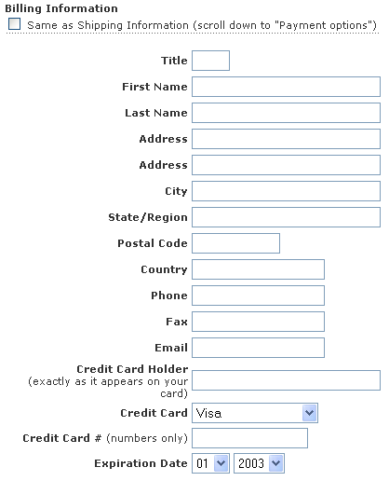
2.9 Forms (1)
A form is the usual way for a server to get information from a browser

Slide 25
2.9 Forms (2)
A form is the usual way for a server to get information from a browser
The objects that implement this information gathering are called widgets (e.g., radio buttons and checkboxes)
When the Submit button of a form is clicked, the form’s values are sent to the server
All of the widgets, or components of a form are defined in the content of a <form> tag
  One most important attribute of <form> is action, which specifies the URL of the application that is to be called when the Submit button is clicked
  <form action = "http://www.ntu.edu.sg/sce/processing.php">
  POST /sce/processing.php HTTP/1.1

Slide 26
2.9 Forms (3)
Widgets
  Many are created with the <input> tag
  The type attribute of <input> specifies the kind of widget being created
Example2-8.html

Slide 27
2.9 Forms (4)
Text – to create a horizontal box for single-line text input
  Default size is 20; it can be changed with the size attribute
  If you don’t want to allow the user to type more characters than will fit, set maxlength, which causes excess input to be ignored
Text areas – used for multi-line text collection
  Created with <textarea>
  rows and cols attributes to specify the size of the text area
  Default text can be included
  The text typed into the area is not limited in length

Slide 28
2.9 Forms (5)
Checkboxes – to collect multiple choice input
  Every checkbox requires a value attribute, which is the widget’s value in the form data when the checkbox is ‘checked’
  A checkbox that is not ‘checked’ contributes no value to the form data
  By default, no checkbox is initially ‘checked’
  To initialize a checkbox to ‘checked’, the checked attribute must be set to "checked“
Radio Buttons – collections of checkboxes in which only ONE button can be ‘checked’ at a time
  Every button in a radio button group MUST have the same name
  value attribute, similar to checkboxes

Slide 29
2.9 Forms (6)
Menus – created with <select> tags
  Two types of menus, those that behave like checkboxes and those that behave like radio buttons (the default)
  Menus that behave like checkboxes are specified by including the multiple attribute, which must be set to "multiple"
    The size attribute of <select> can be included to specify the number of menu items to be displayed (the default is 1)
    If size is set to > 1 or multiple is specified, the menu is usually displayed as a scrolled list
  Each item of a menu is specified with an <option> tag, whose pure text content is the value of the item
  An <option> tag can include the selected attribute, which when assigned "selected" specifies that the item is preselected

Slide 30
2.9 Forms (7)
Reset and Submit buttons
  Both are created with <input>
  Reset button clears all widgets in the form to their initial states
  Submit has two actions:
    Encode the data of the form and send them to the server
    Request that the server executes the server-resident program specified as the value of the action attribute of <form>
  A Submit button is required in every form

Slide 31
2.10 Summary
HTML for standardized documents (NOT a program)
Tags and attributes
Hypertext links
Forms for data collections
Rich online resources
  http://www.w3schools.com/html/
  http://en.wikipedia.org/wiki/HTML
  http://www.htmldog.com/

